Slide 1
CIS CONTROL 12: BOUNDARY DEFENSE - I
BOUNDARY DEFENSE

Slide 2
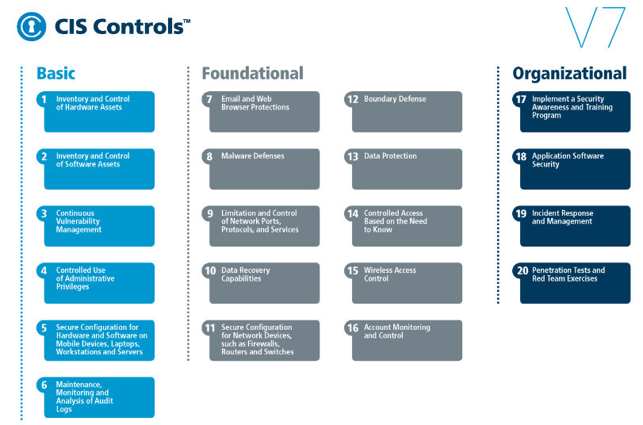
CIS CONTROL 12: BOUNDARY DEFENSE - I
https://www.cisecurity.org/controls/

Slide 3
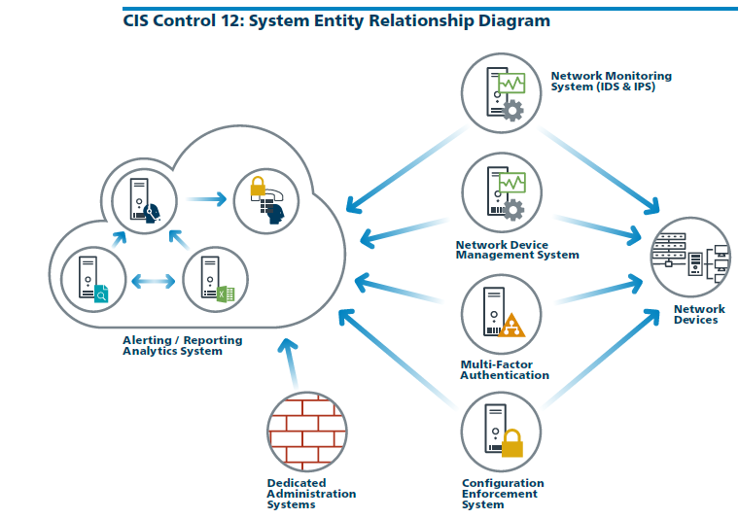
CIS CONTROL 12: BOUNDARY DEFENSE - I
https://www.cisecurity.org/controls/

Slide 4
CIS CONTROL 12: BOUNDARY DEFENSE - I
12.1: Maintain an Inventory of Network Boundaries
Maintain an up-to-date inventory of all of the organization's network boundaries.

Slide 5
CIS CONTROL 12: BOUNDARY DEFENSE - I
12.2: Scan for Unauthorized Connections across Trusted Network Boundaries
Perform regular scans from outside each trusted network boundary to detect any unauthorized connections which are accessible across the boundary.

Slide 6
CIS CONTROL 12: BOUNDARY DEFENSE - I
12.3: Deny Communications with Known Malicious IP Addresses
Deny communications with known malicious or unused Internet IP addresses and limit access only to trusted and necessary IP address ranges at each…

Slide 7
CIS CONTROL 12: BOUNDARY DEFENSE - I
12.3: Deny Communications with Known Malicious IP Addresses
…of the organization's network boundaries.

Slide 8
CIS CONTROL 12: BOUNDARY DEFENSE - I
12.4: Deny Communication over Unauthorized Ports
Deny communication over unauthorized TCP or UDP ports or application traffic to ensure that only authorized protocols are allowed to cross the network boundary in or out of the network at…

Slide 9
CIS CONTROL 12: BOUNDARY DEFENSE - I
12.4: Deny Communication over Unauthorized Ports
…each of the organization's network boundaries.
END

